Slide 1
D-train 5th Wheel Compound Hitch and Stinger Semi-trailers
NZR
N. Royce Curry
President
National Zephyr Research

Slide 2
D-train 5th Wheel Compound Hitch
Eliminates articulation (yaw) at the tractor
Stinger Semi-trailers increasing capacity
Vocational trucks with demountable bodies
Universal tractor becomes Work Truck
Utility vehicles, with 3:1 ratio truck bodies
Tractor
Semi-trailer
Vocational
Utility
Resources
Military

Slide 3
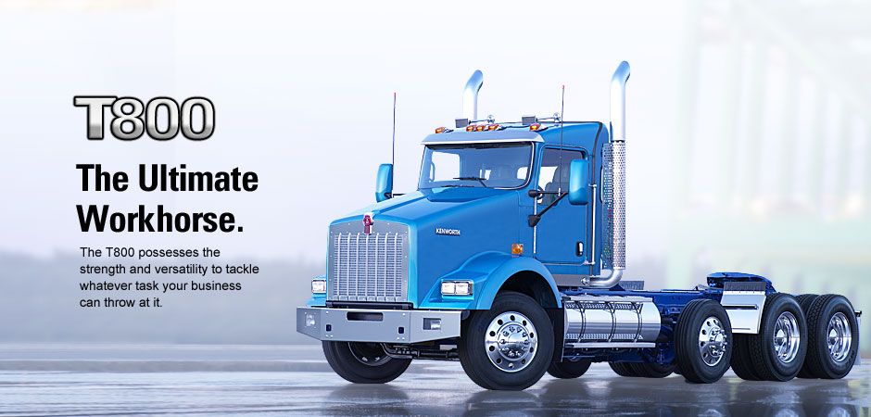
D-train 5th Wheel Compound Hitch and Universal Tractor

Slide 4
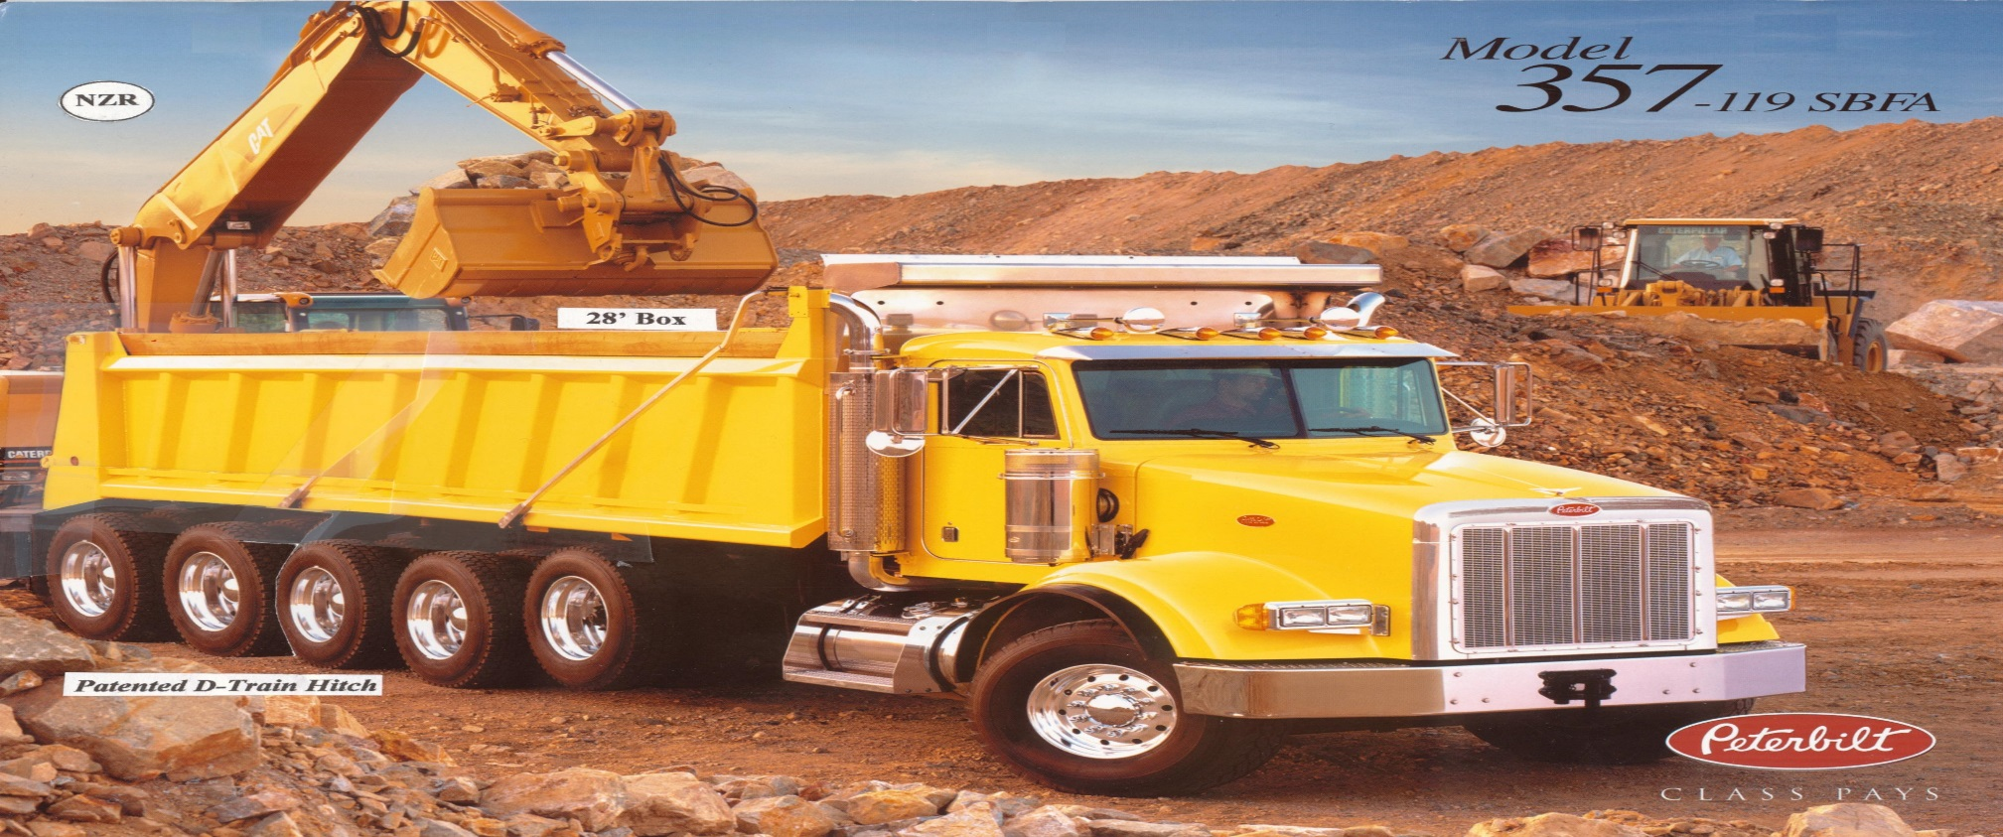
D-train 5th Wheel Compound Hitch Universal Tractor c/w 28’ Tandem Dump

Slide 5
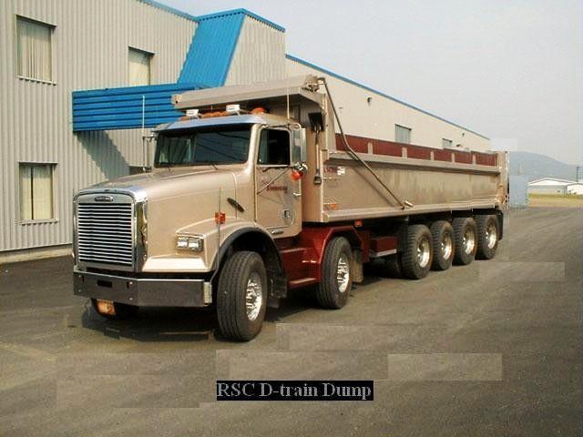
D-train 5th Wheel Compound Hitch
Universal Tractor c/w 28’ Tandem Dump

Slide 6
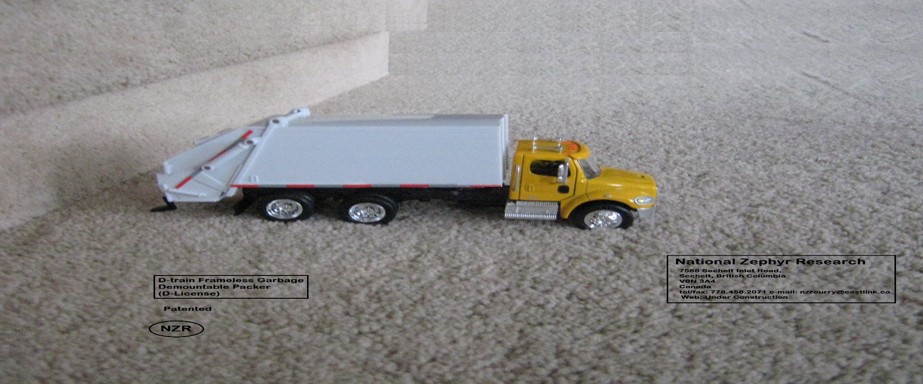
D-train 5th Wheel Compound Hitch
Tractor Refuse Packer

Slide 7
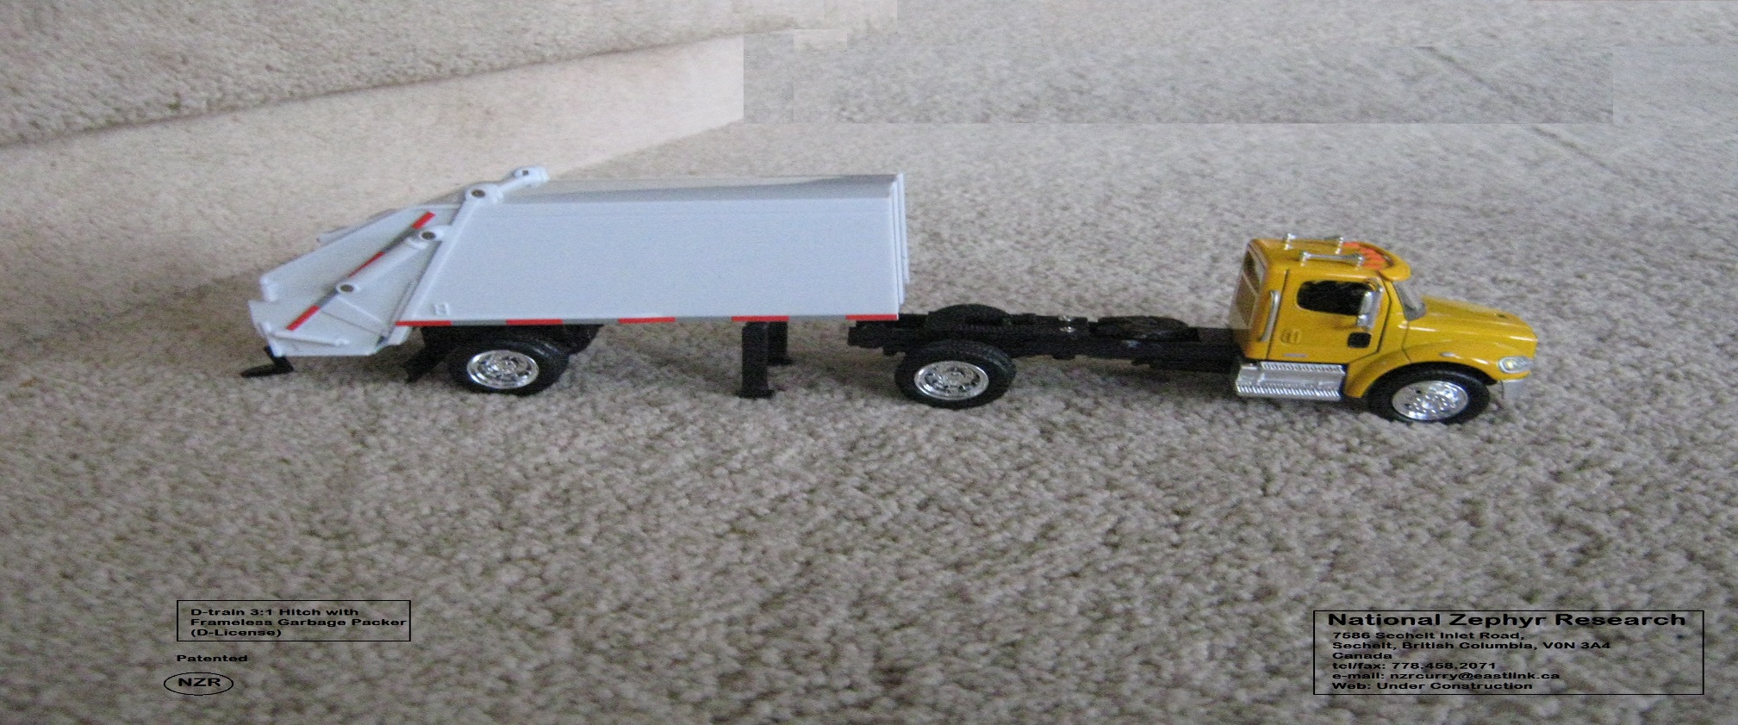
D-train 5th Wheel Compound Hitch
Tractor & Dismounted Packer

Slide 8
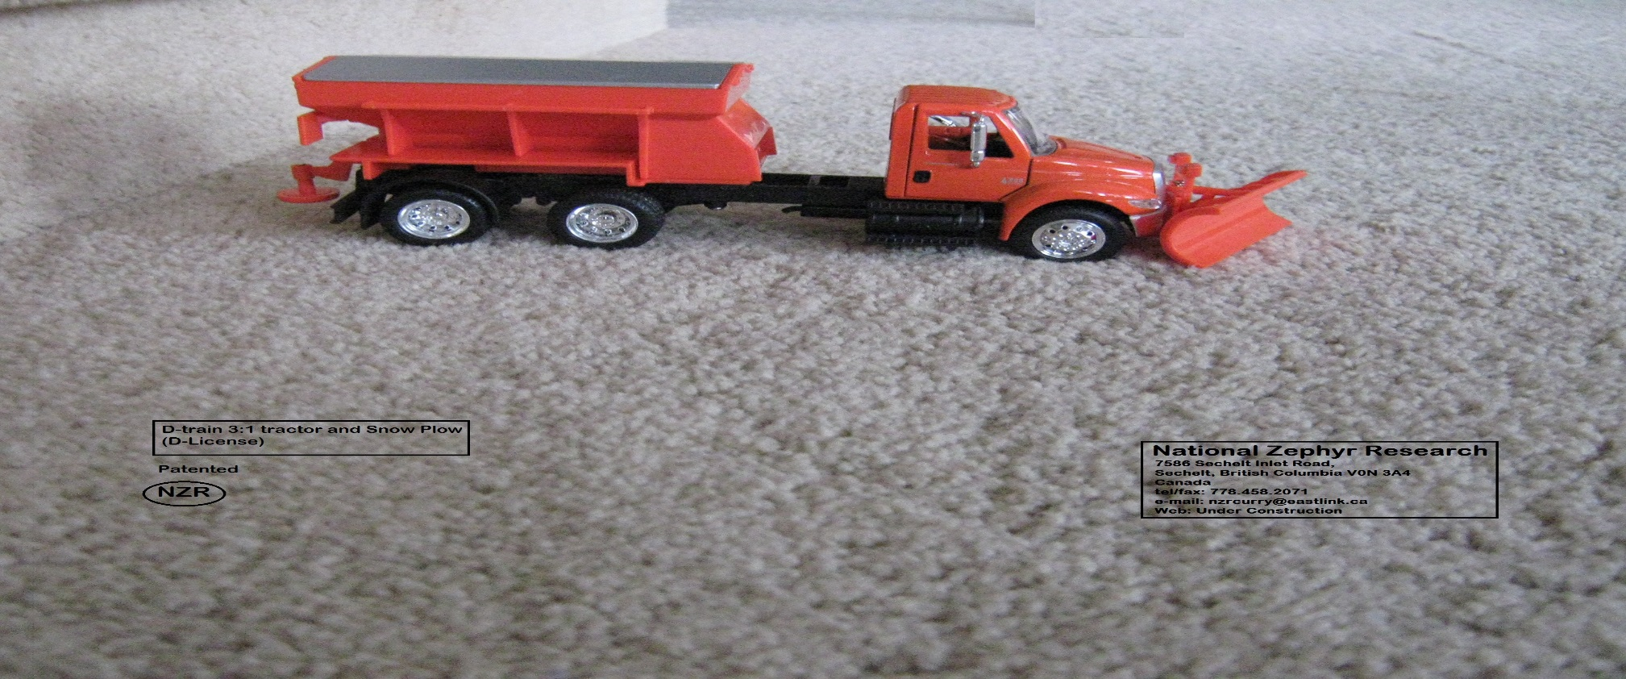
D-train 5th Wheel Compound Hitch
Tractor & Salt Spreader

Slide 9
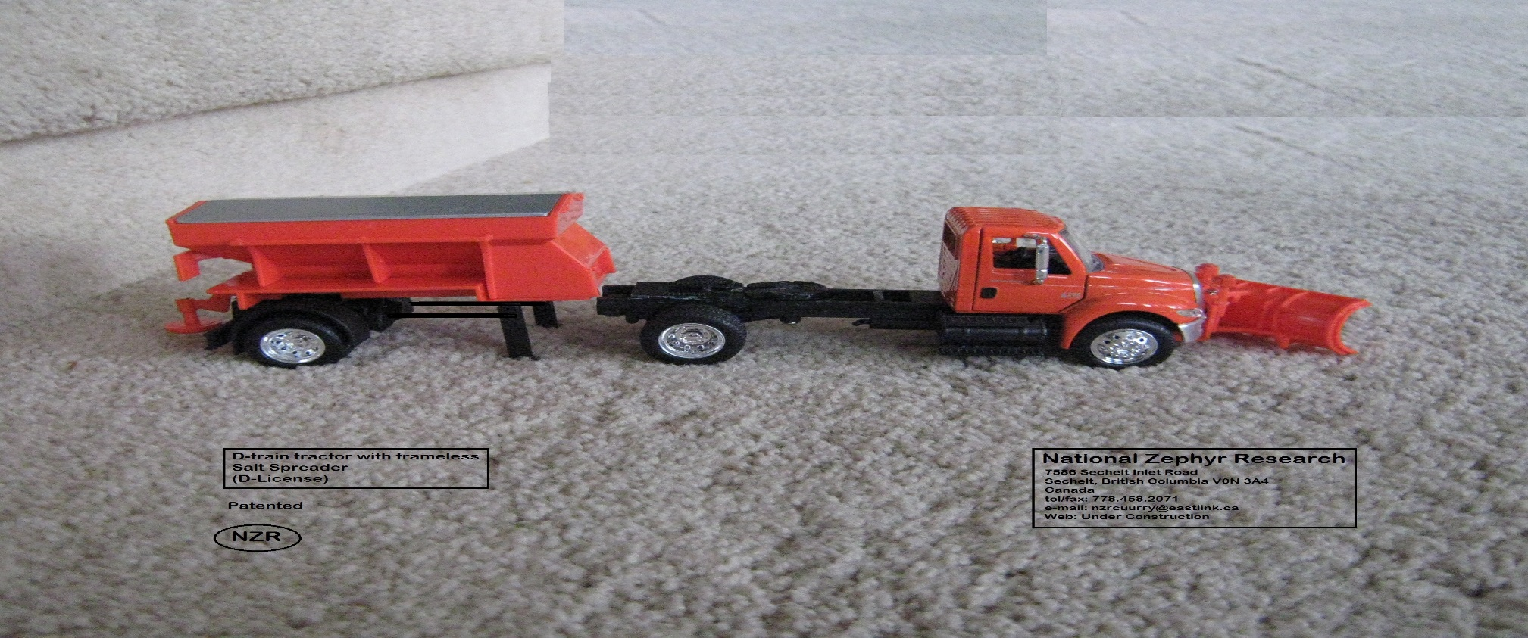
D-train 5th Wheel Compound Hitch
Tractor c/w Dismounted Spreader

Slide 10
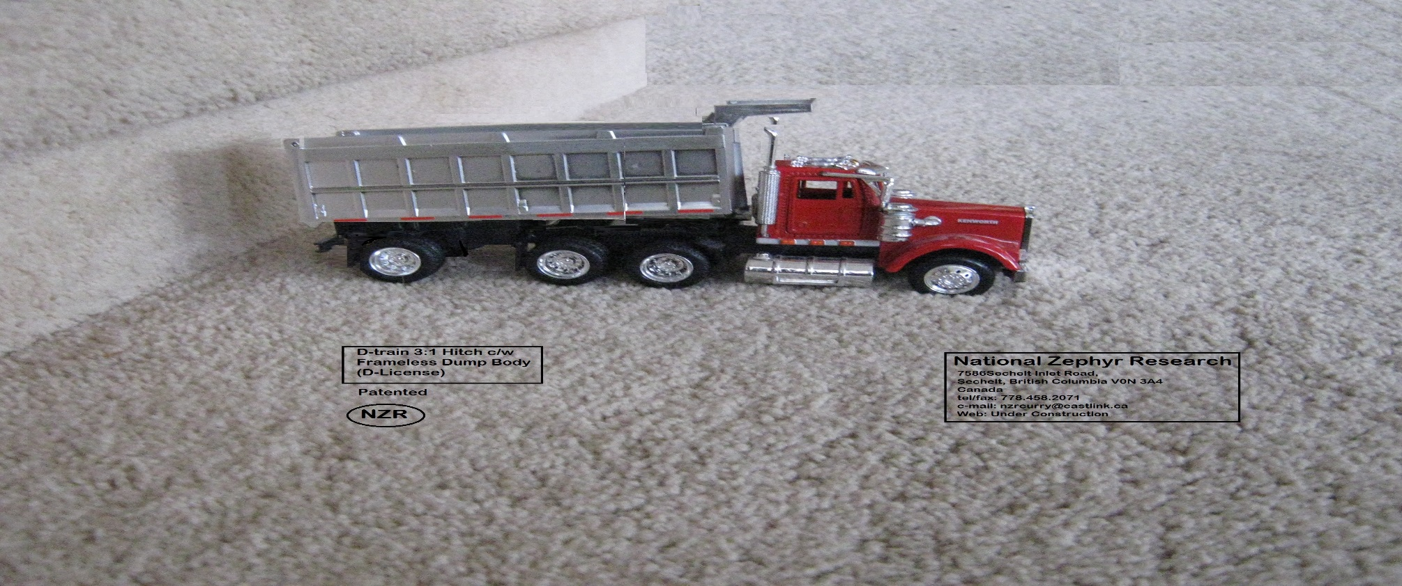
D-train 5th Wheel Compound Hitch
Tractor c/w Coal Dump Body

Slide 11
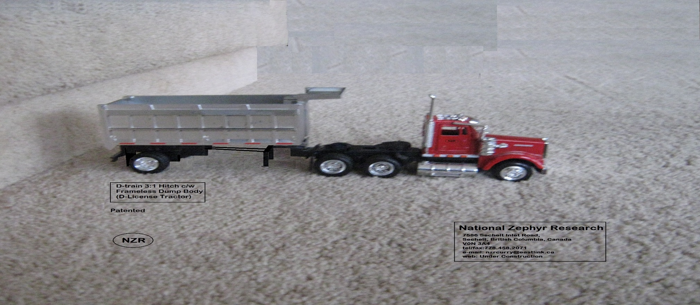
D-train 5th Wheel Compound Hitch
Tractor c/w Dismounted Coal Body

Slide 12
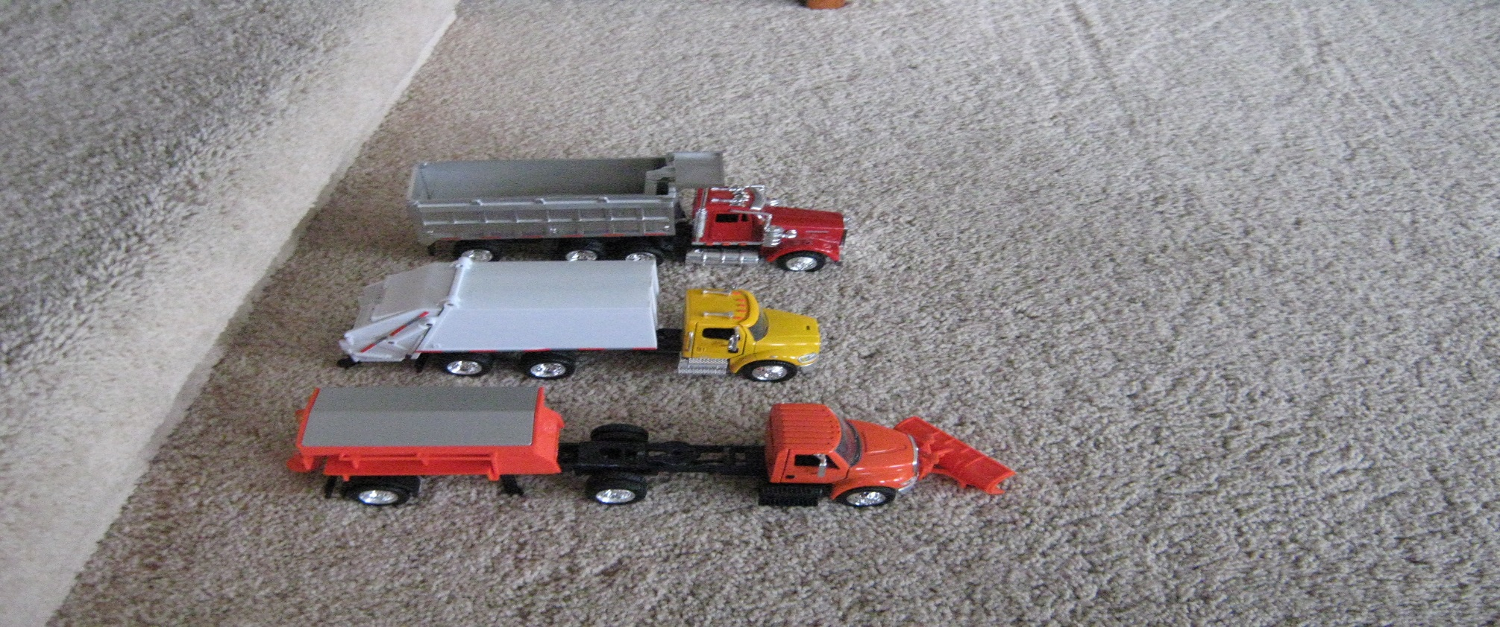
Utility Vehicles for Universal application using D-train 5th Wheel Compound Hitch

Slide 13
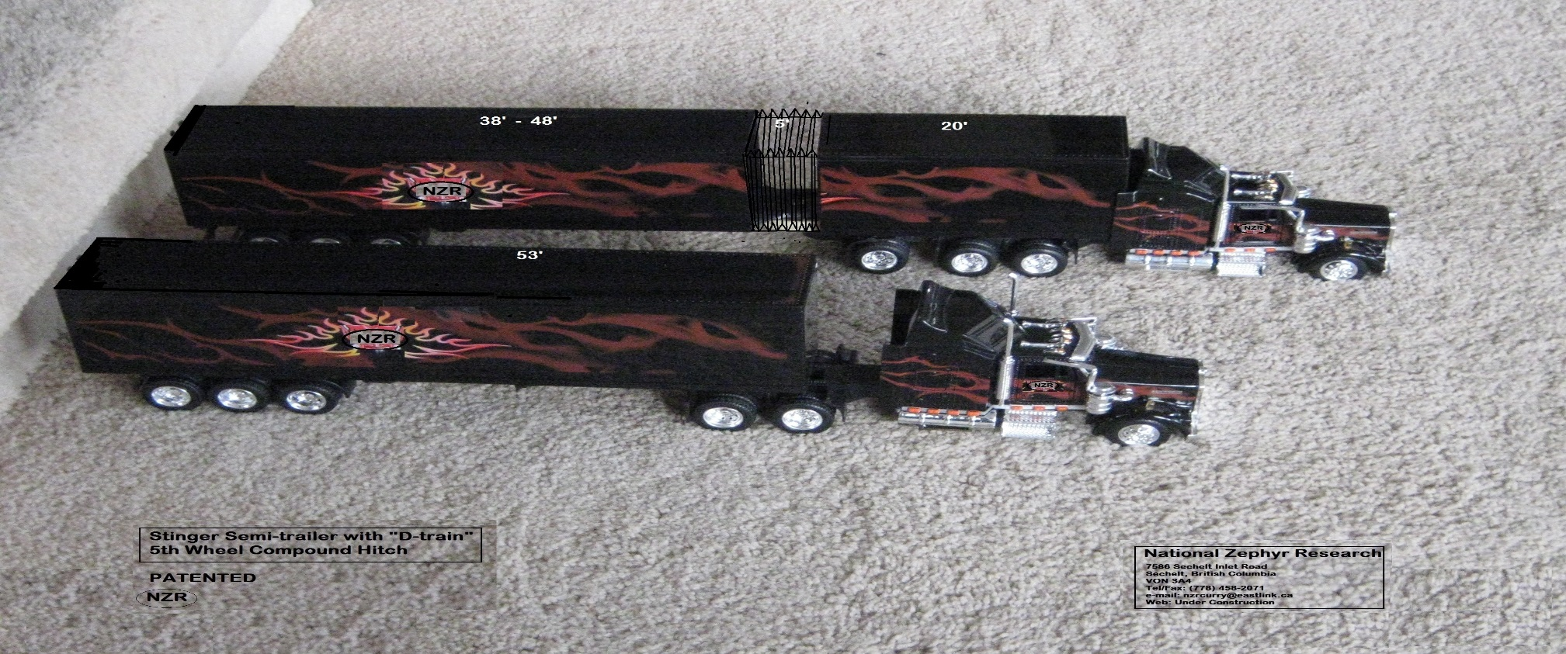
Tractor D-train 5th Wheel Hitch System
& Stinger 73’ Semi-trailer (COE 82’OAL)

Slide 14
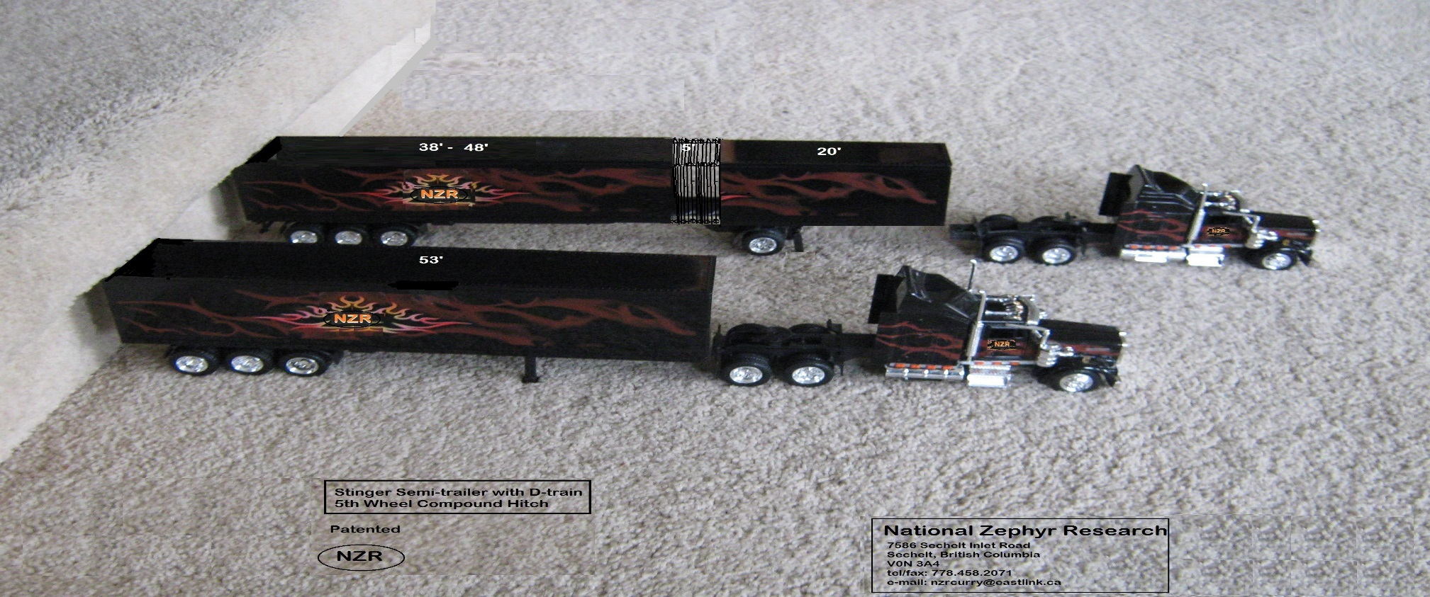
D-train 5th Wheel Compound Hitch
Tractor c/w Stinger Trailer Detached

Slide 15
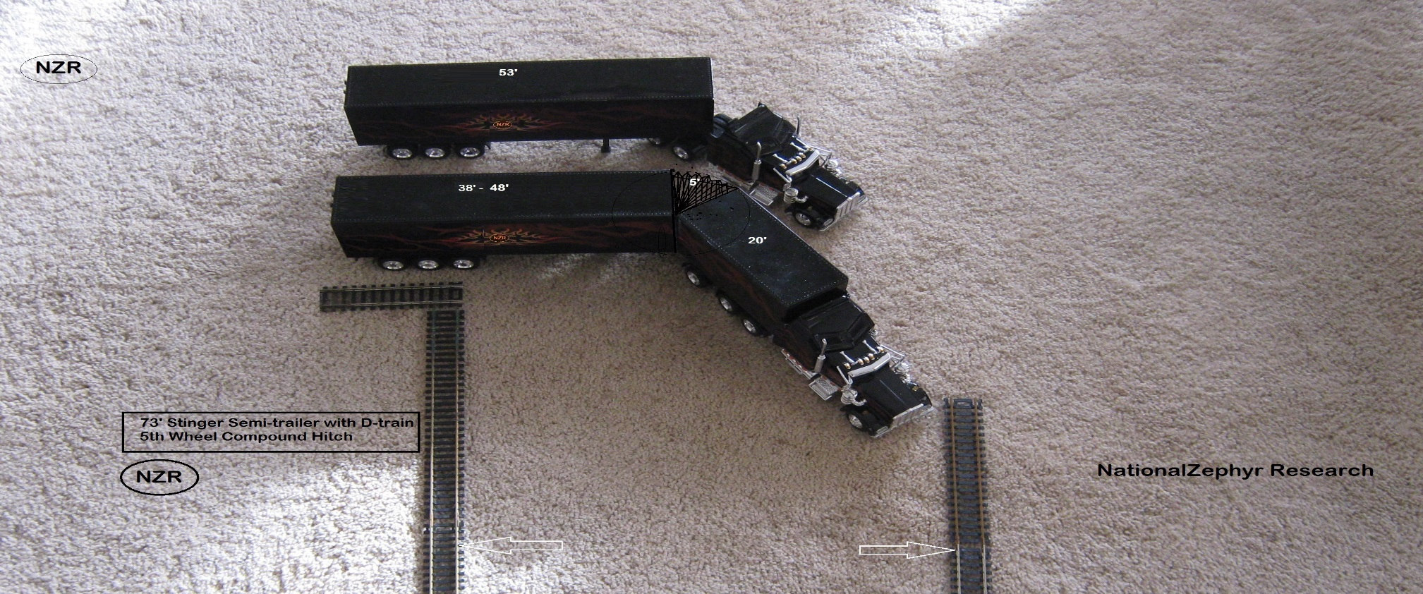
Universal tractor c/w D-train 5th Wheel Compound Hitch Off-tracking

Slide 16
For-Hire Carrier Economics Before D-train
Any year with an operating ratio of 94% is a welcome outcome!

Slide 17
For Hire Carrier Economics with D-train – Same Revenue
D-train Impact:
Operating Ratio = 85%
Net Profit Improvement = 400%

Slide 18
For-Hire Carrier Economics with D-train –Incremental Revenue:

